Slide 1
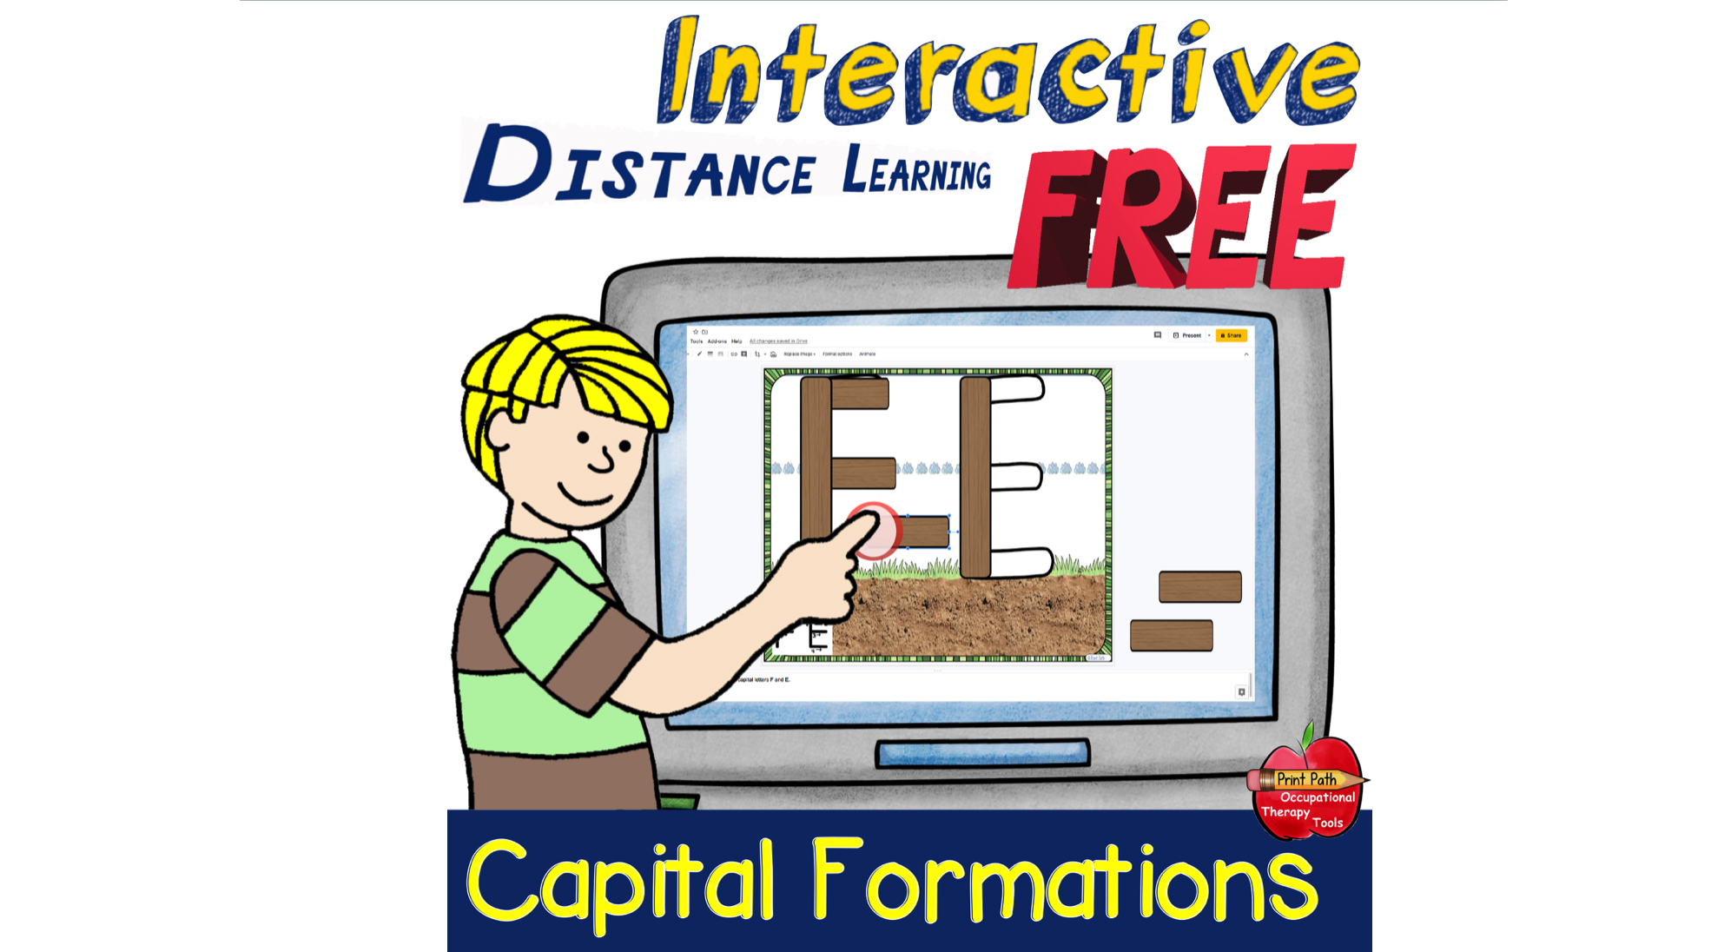

Slide 2
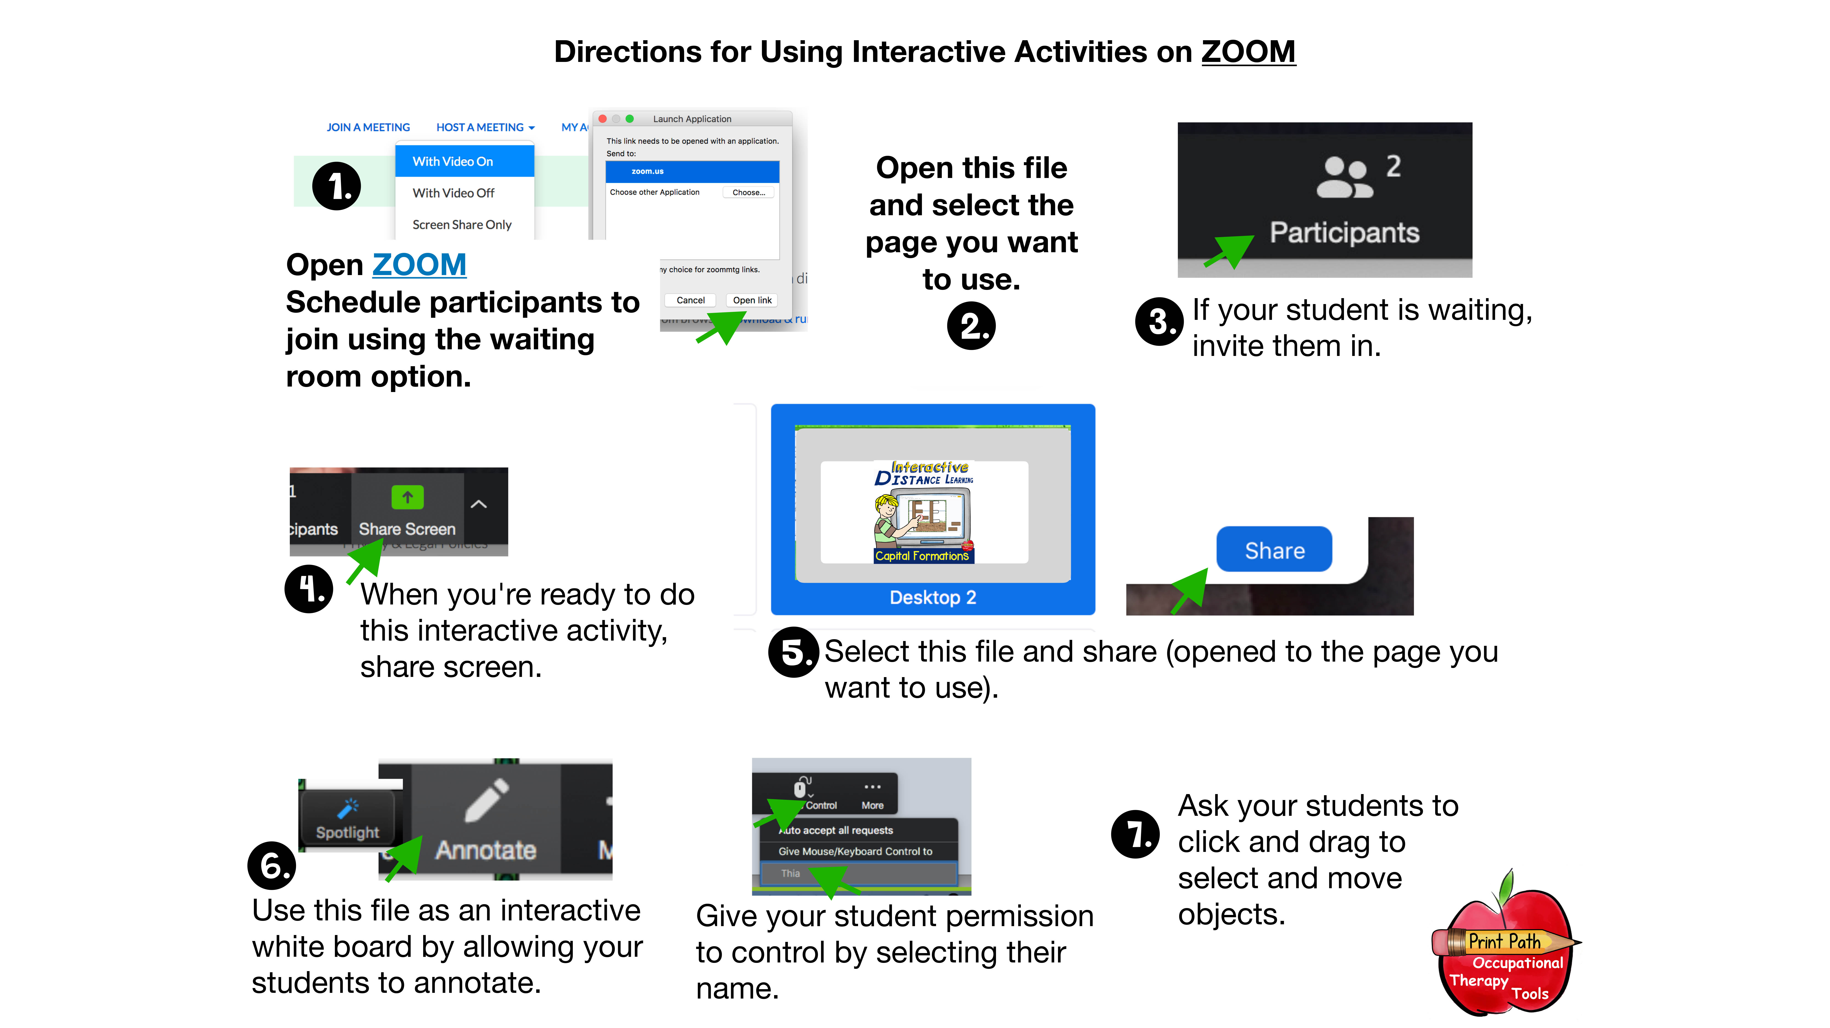

Slide 3
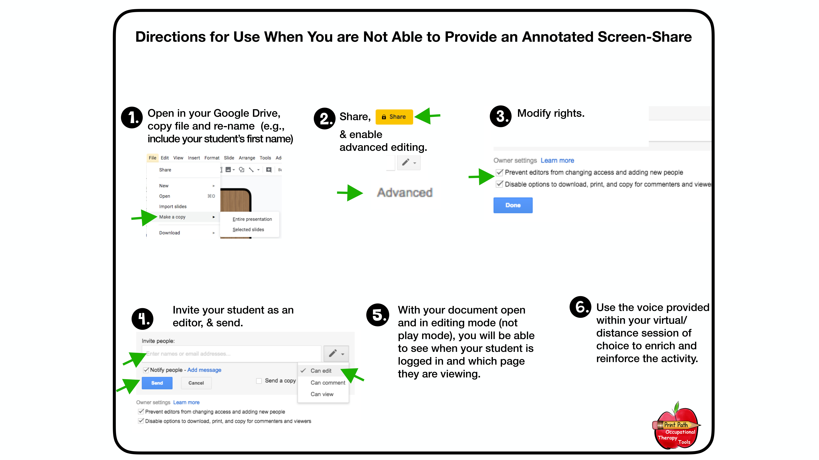

Slide 4
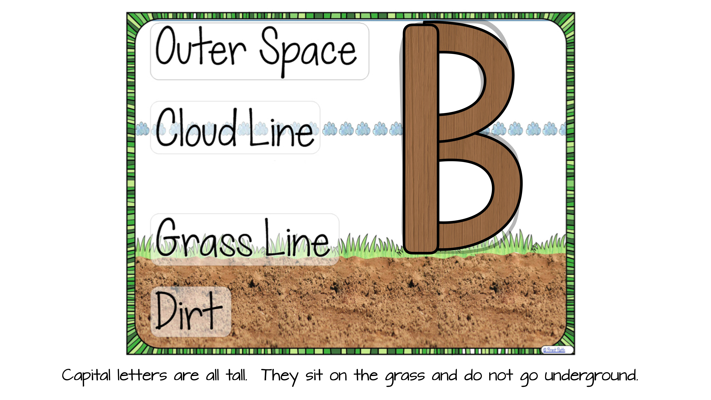

Slide 5
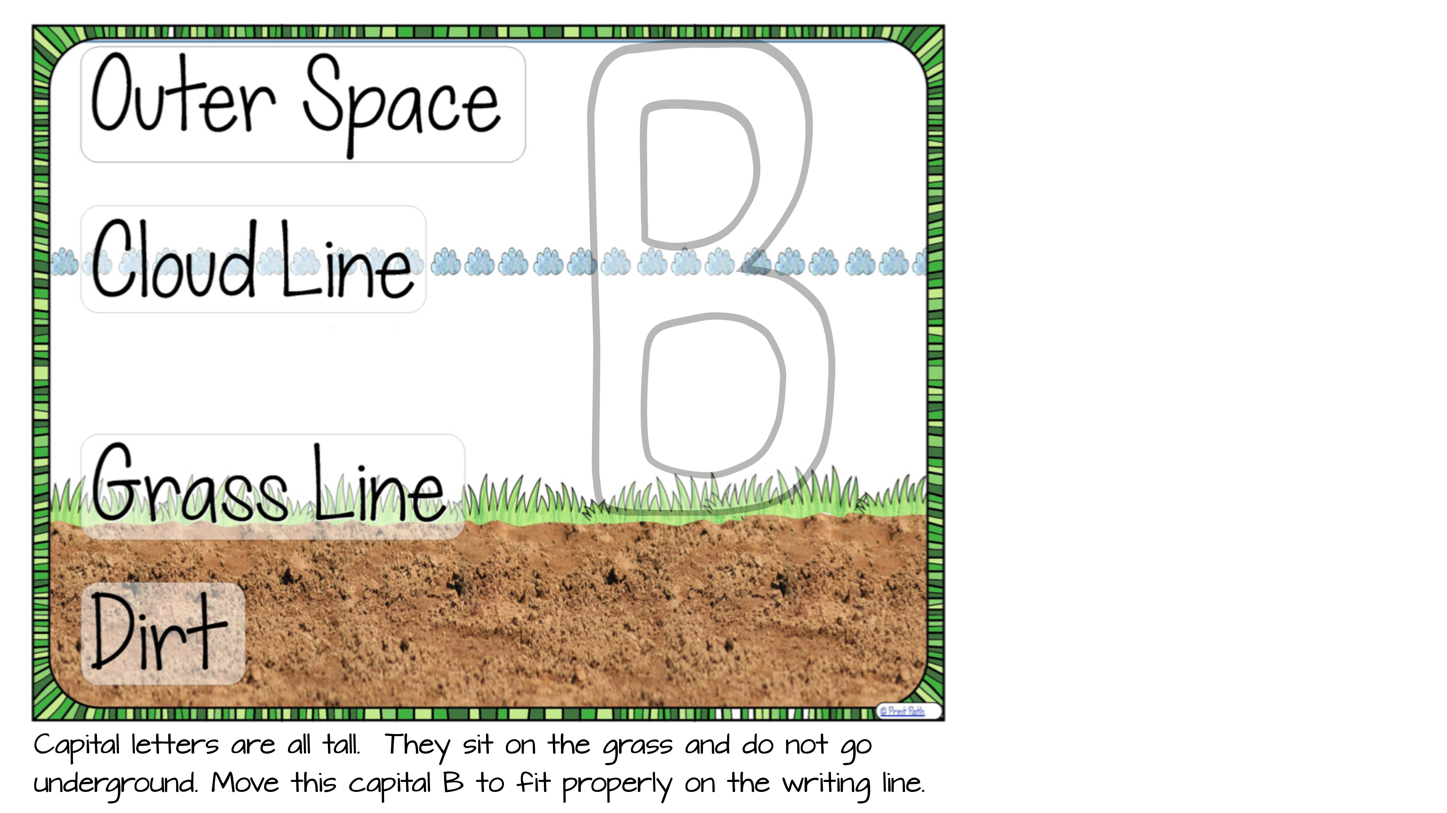


Slide 6
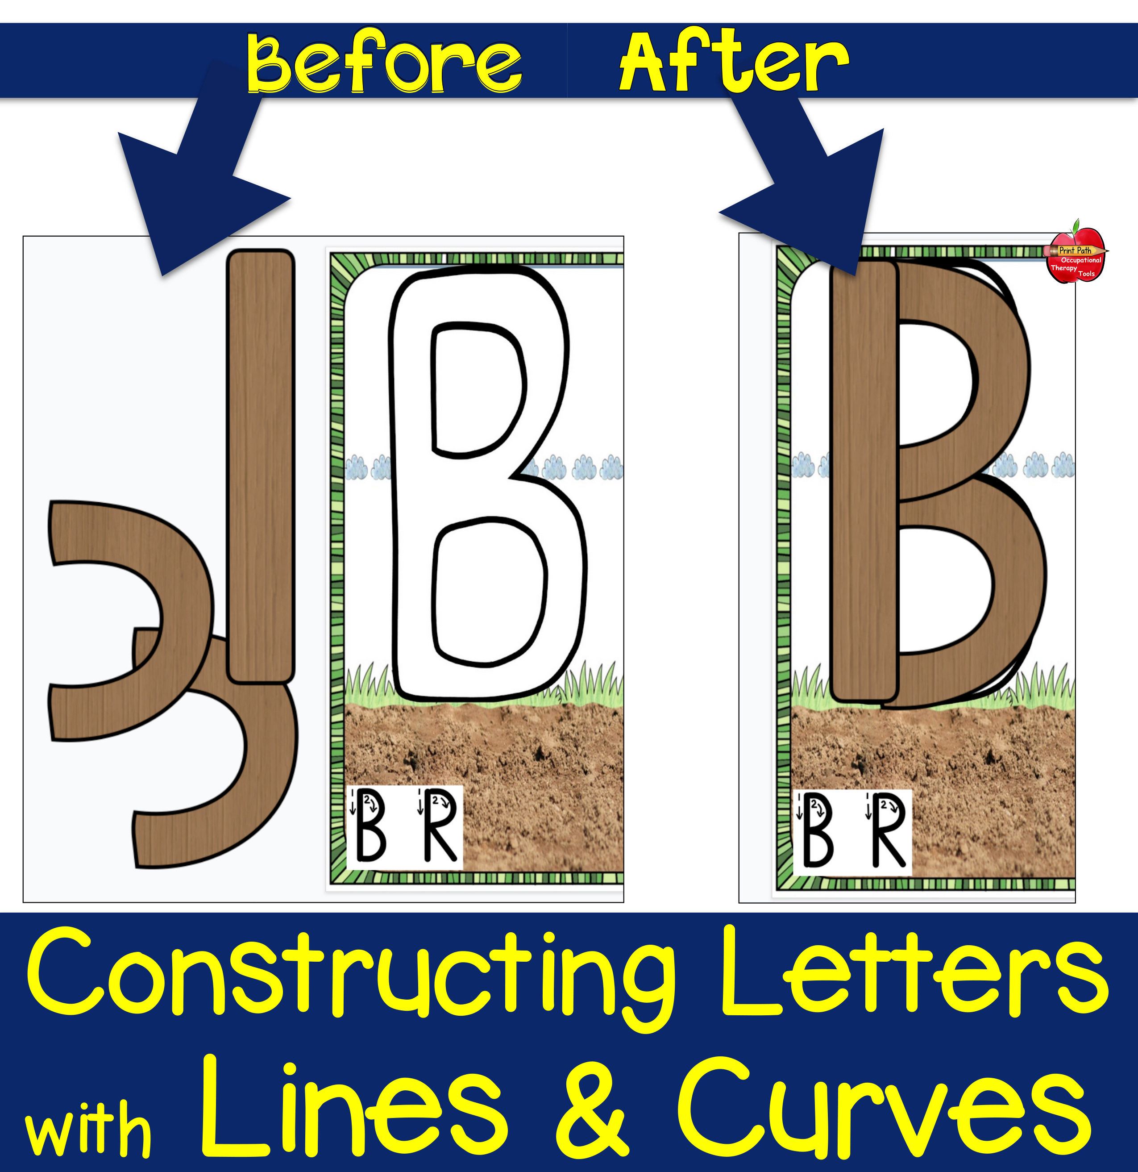

Slide 7
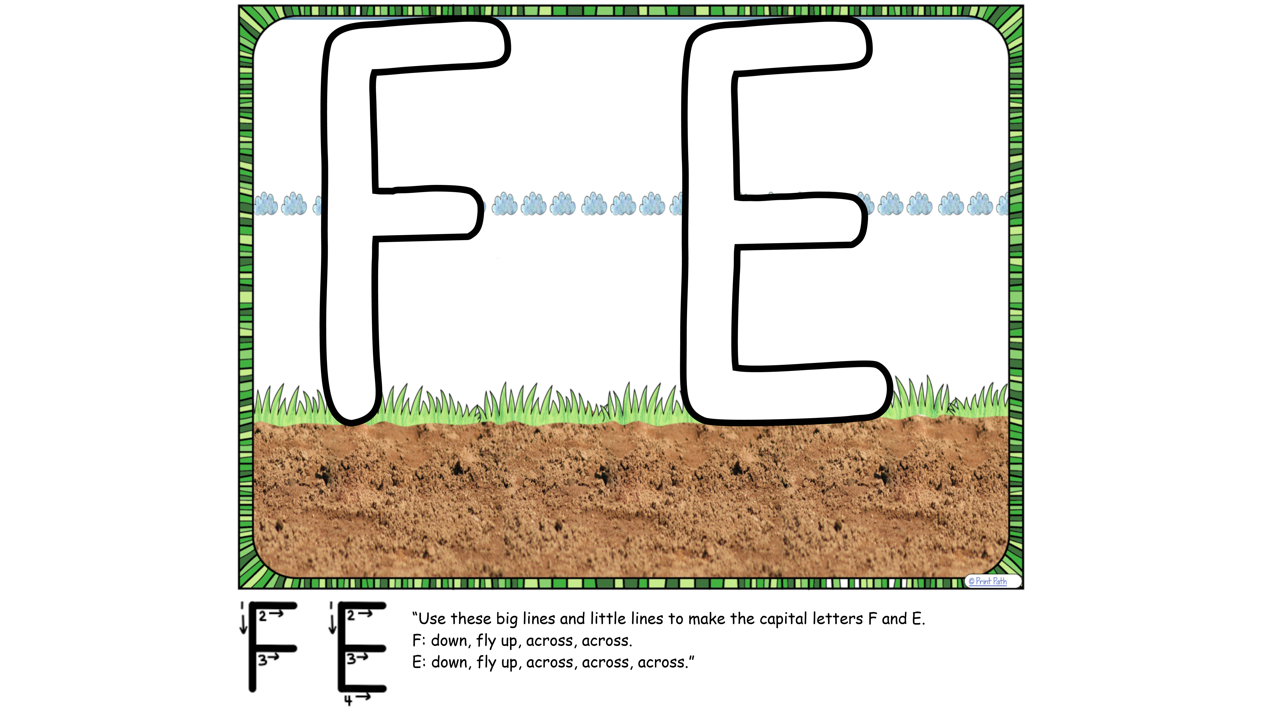


Slide 8
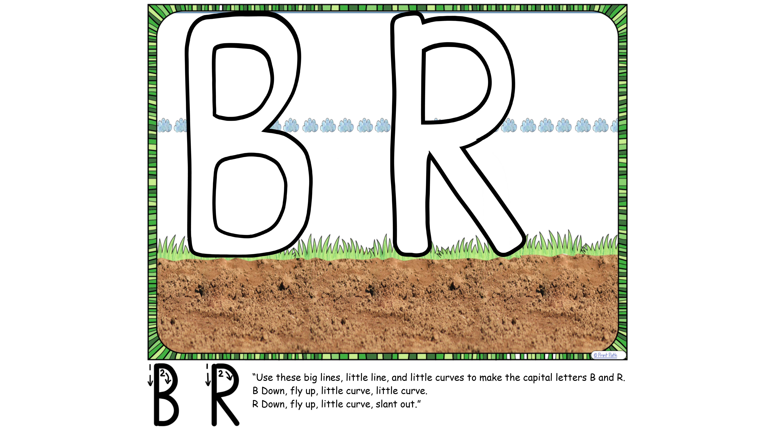

Slide 9
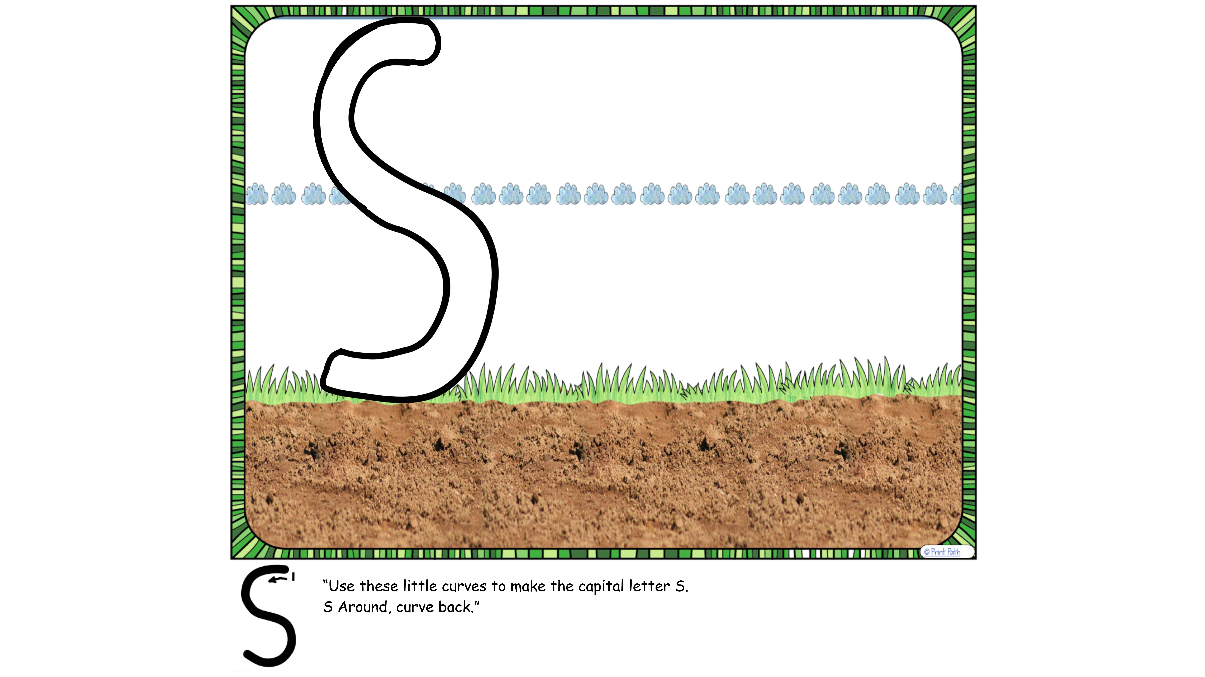

Slide 10
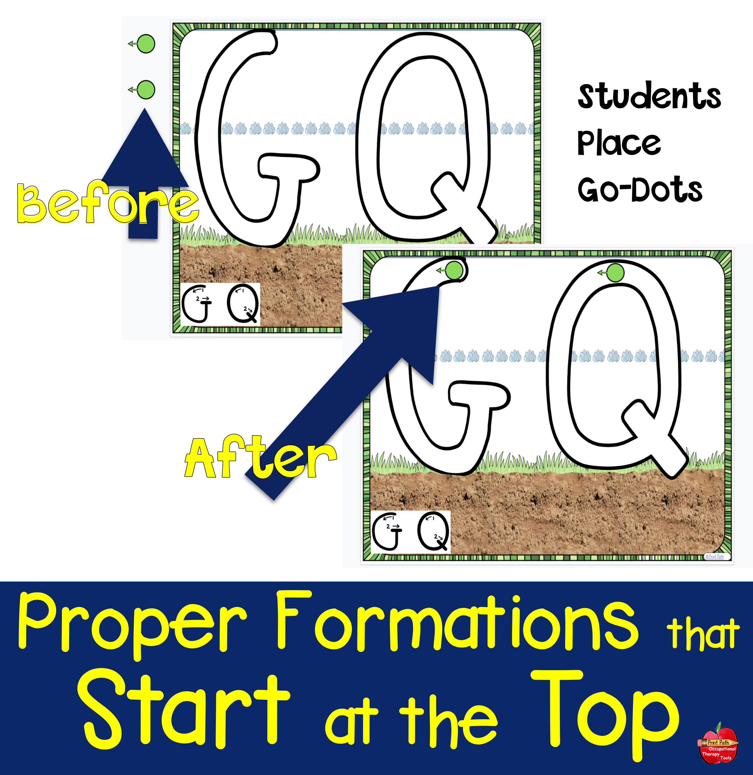

Slide 11


Slide 14




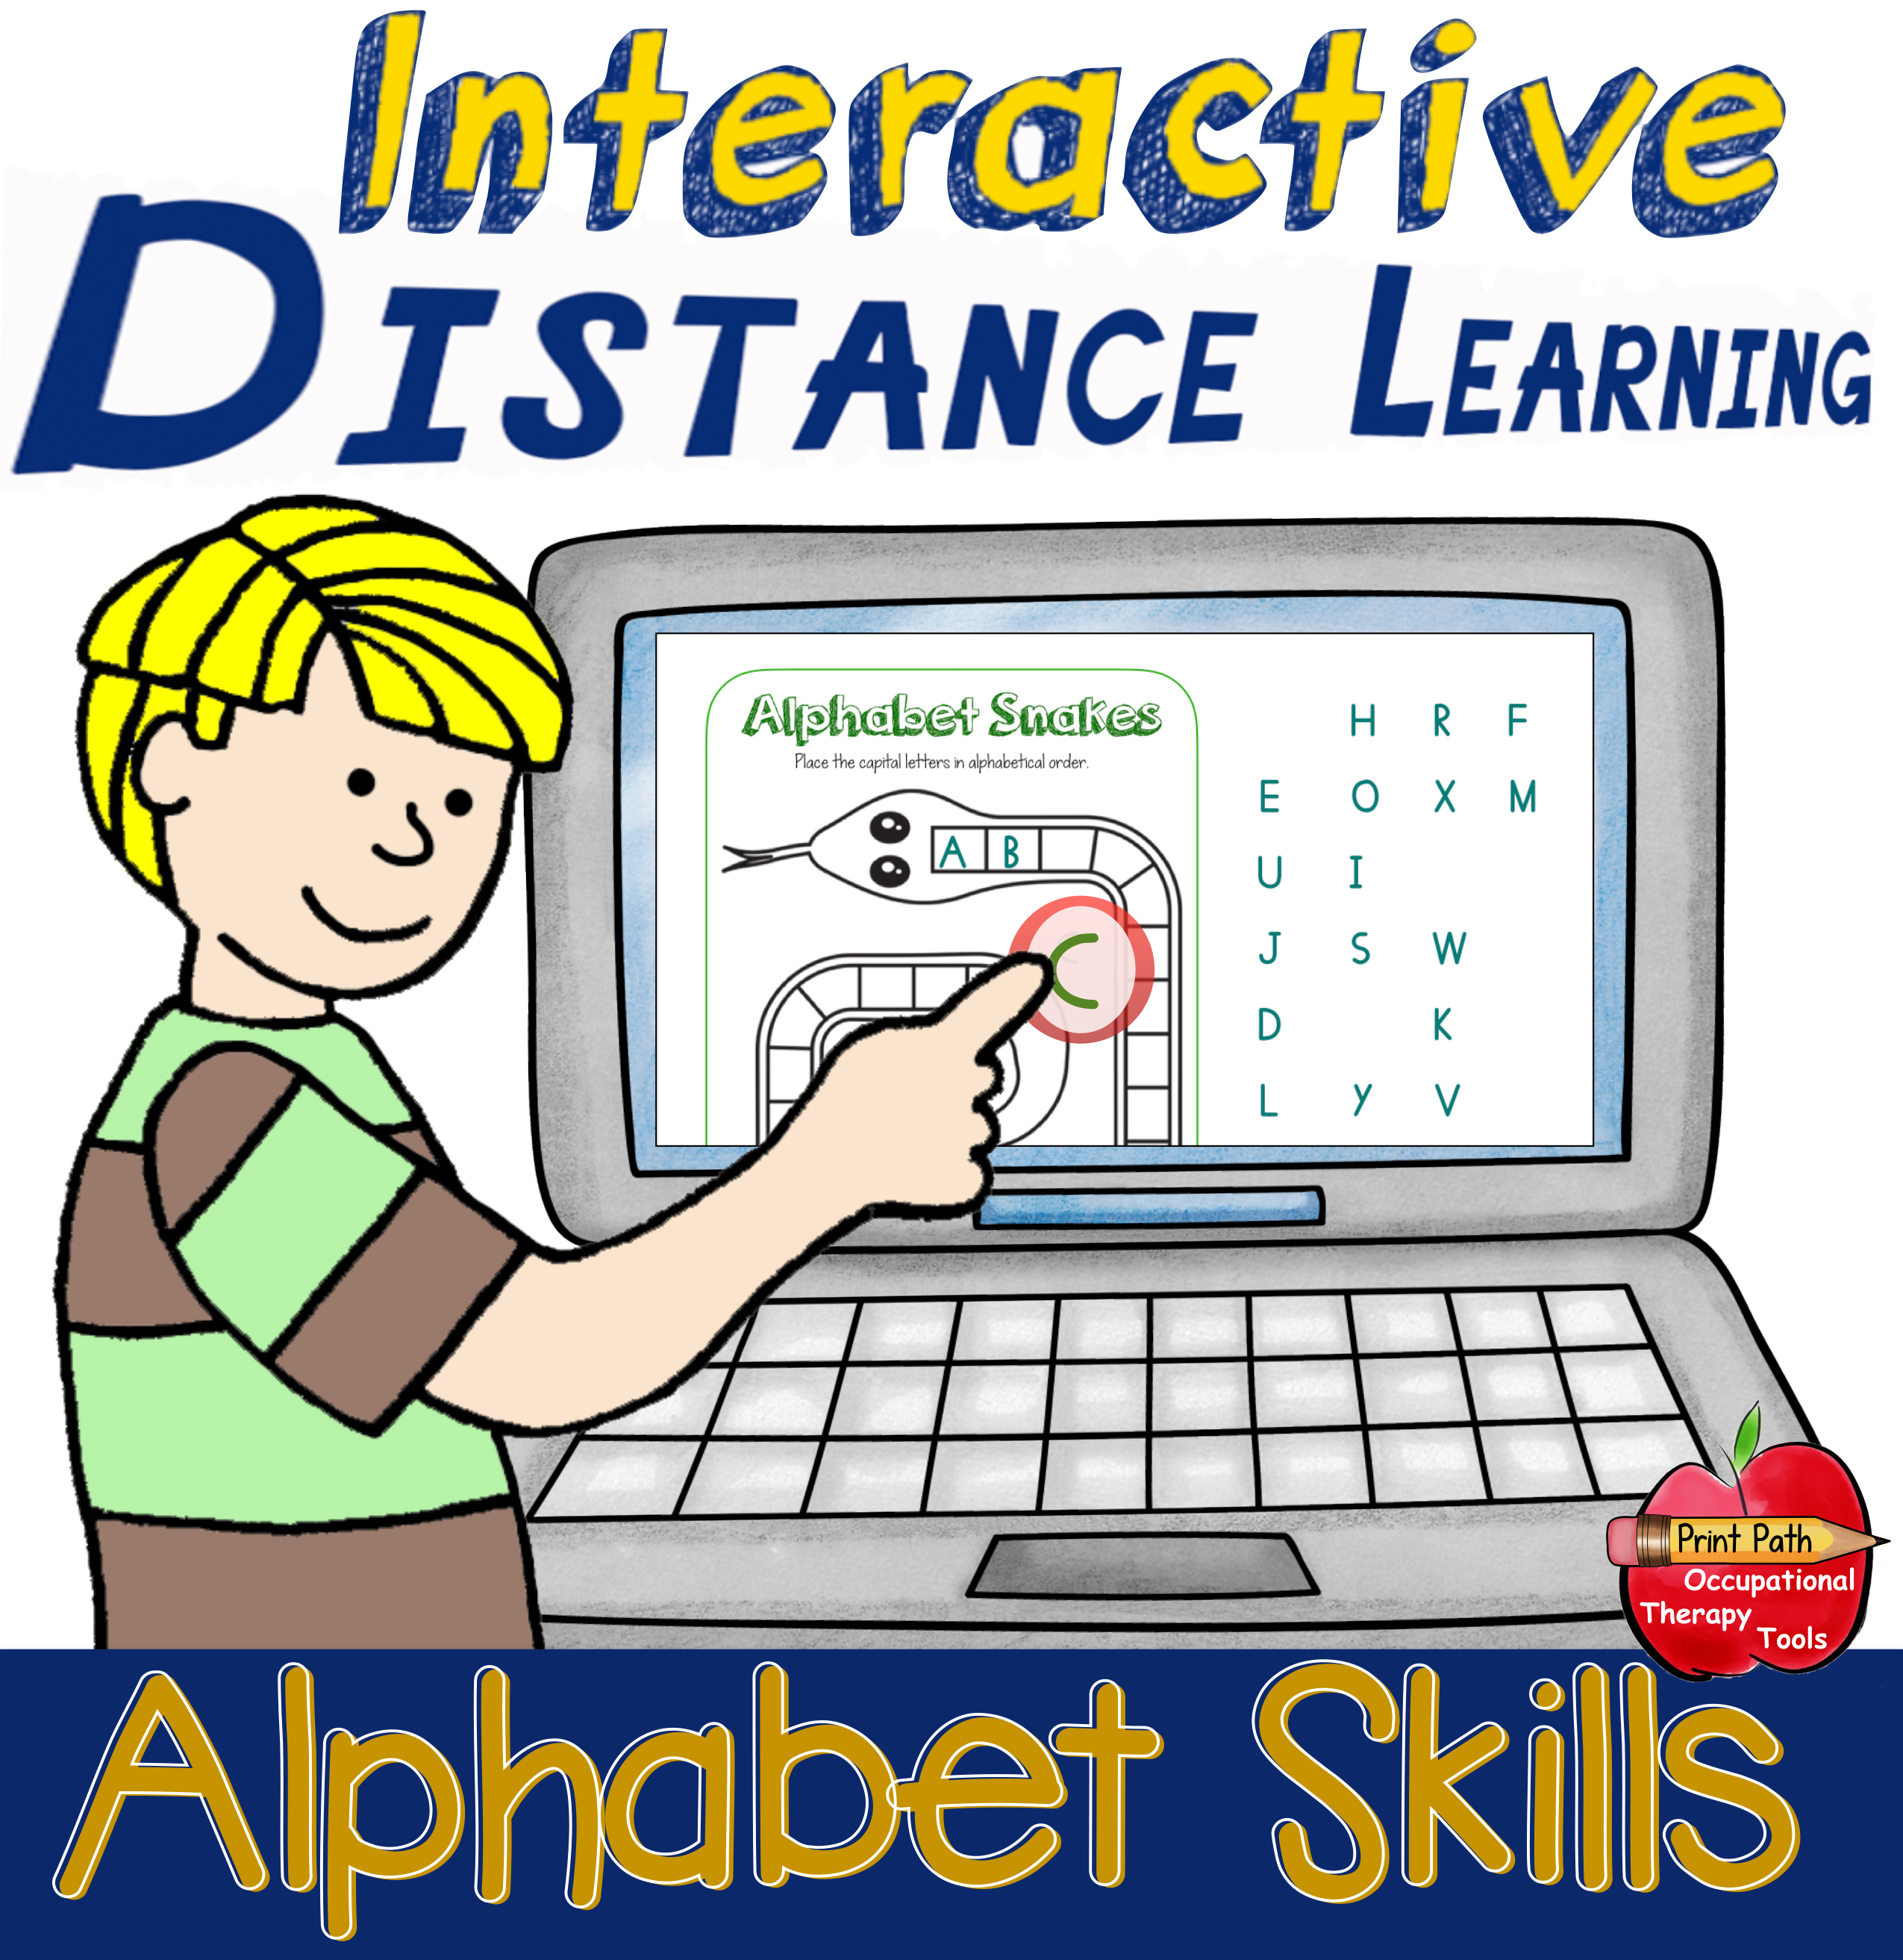
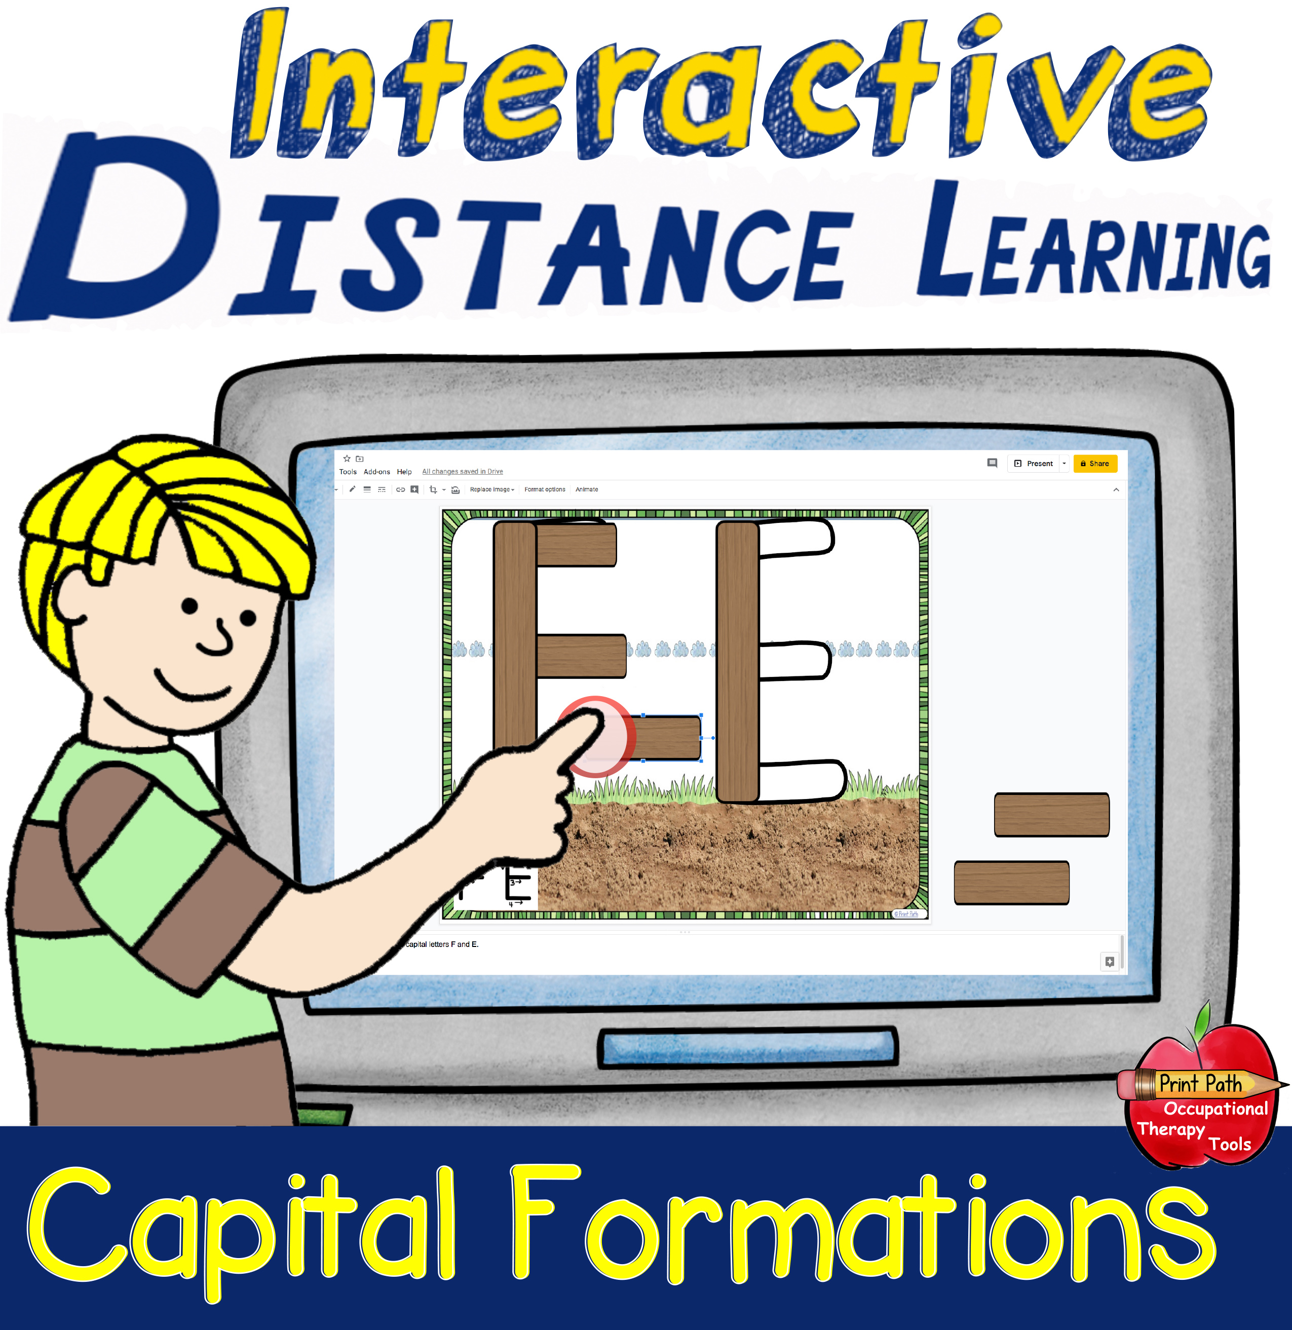
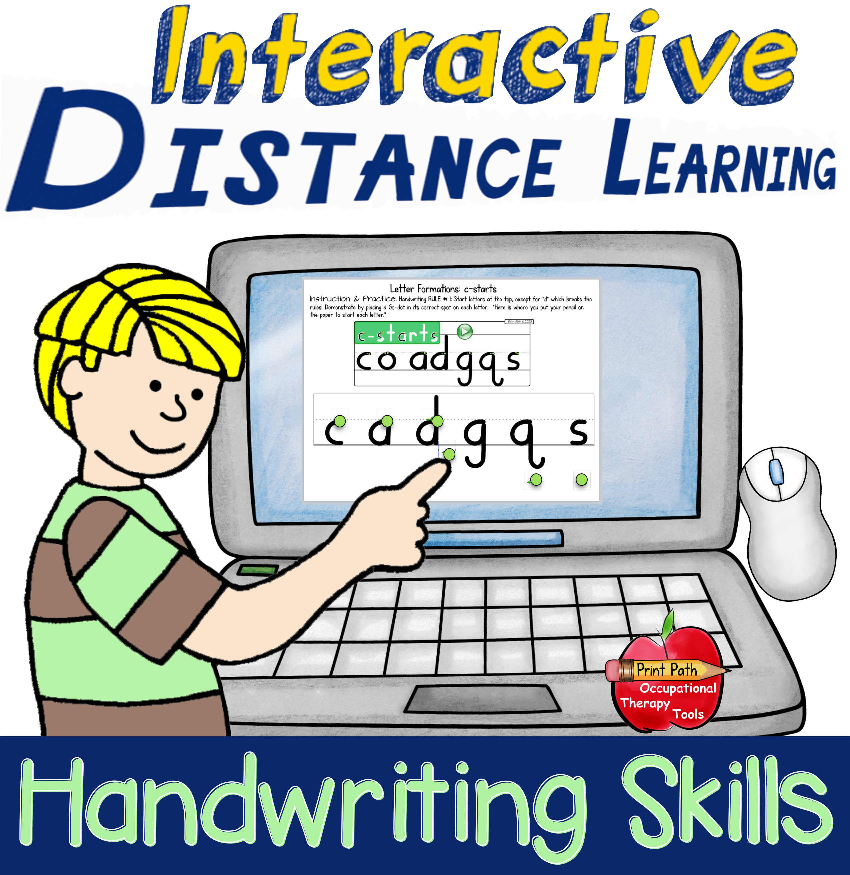
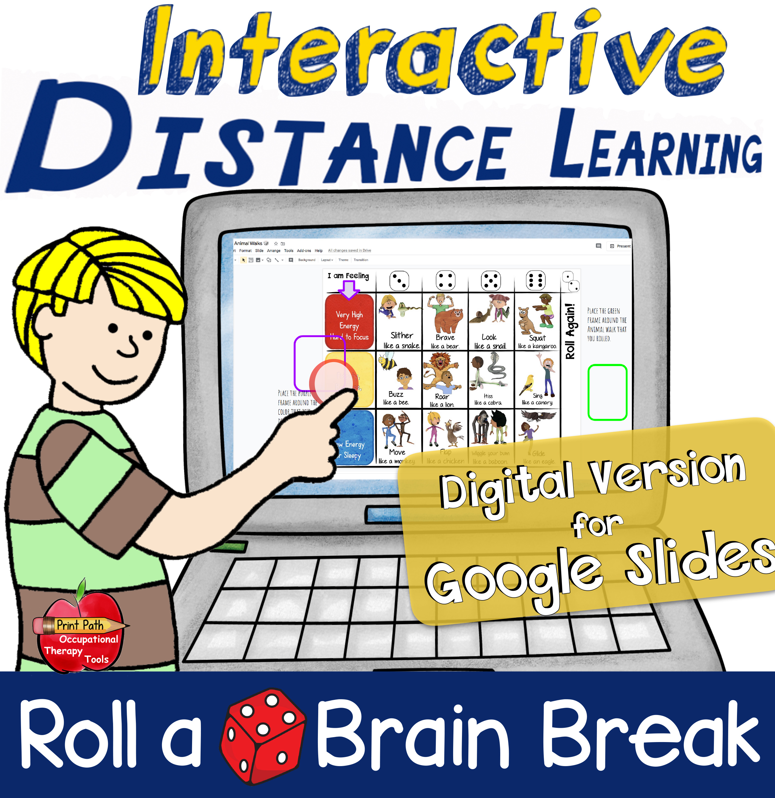
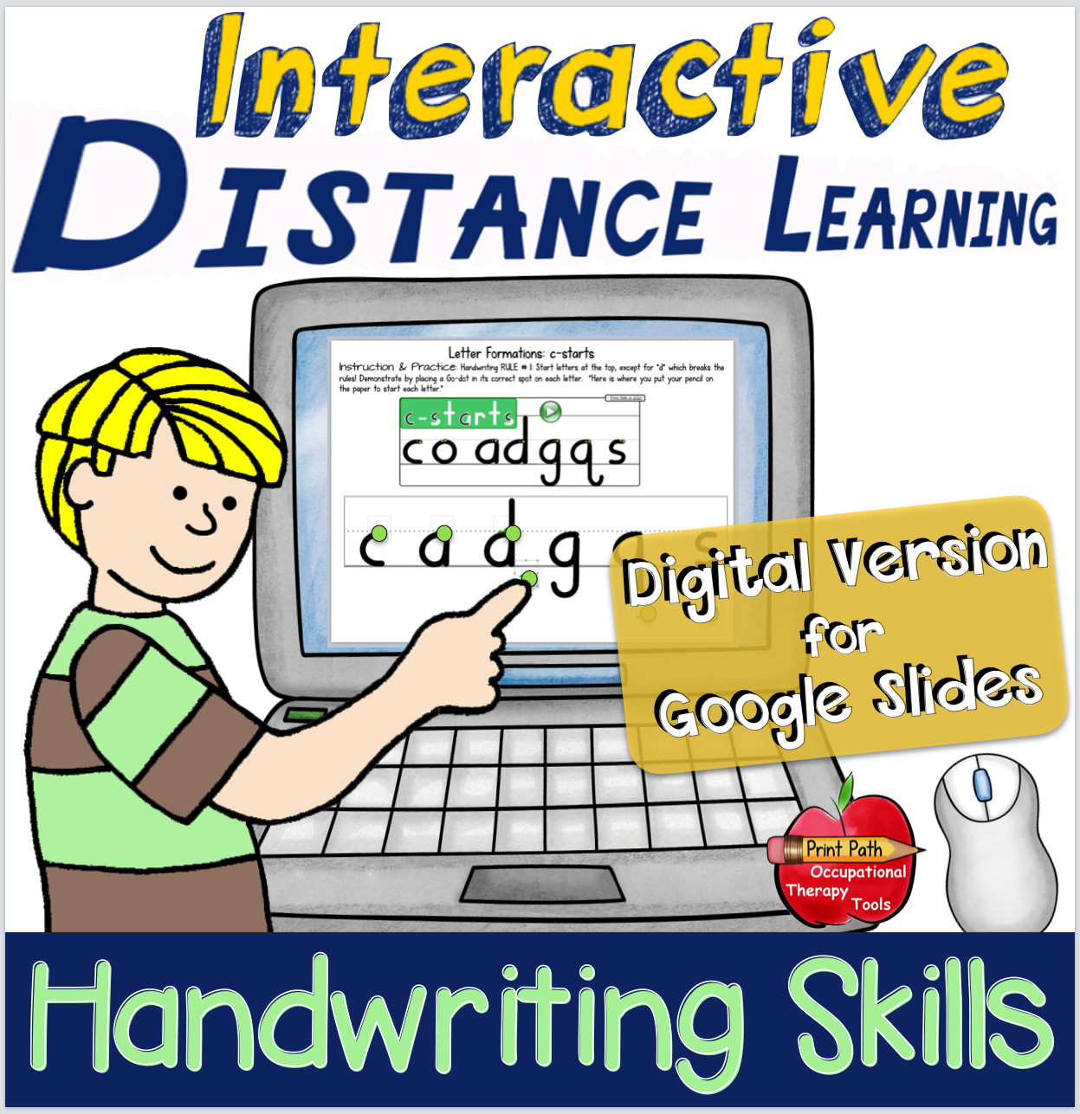
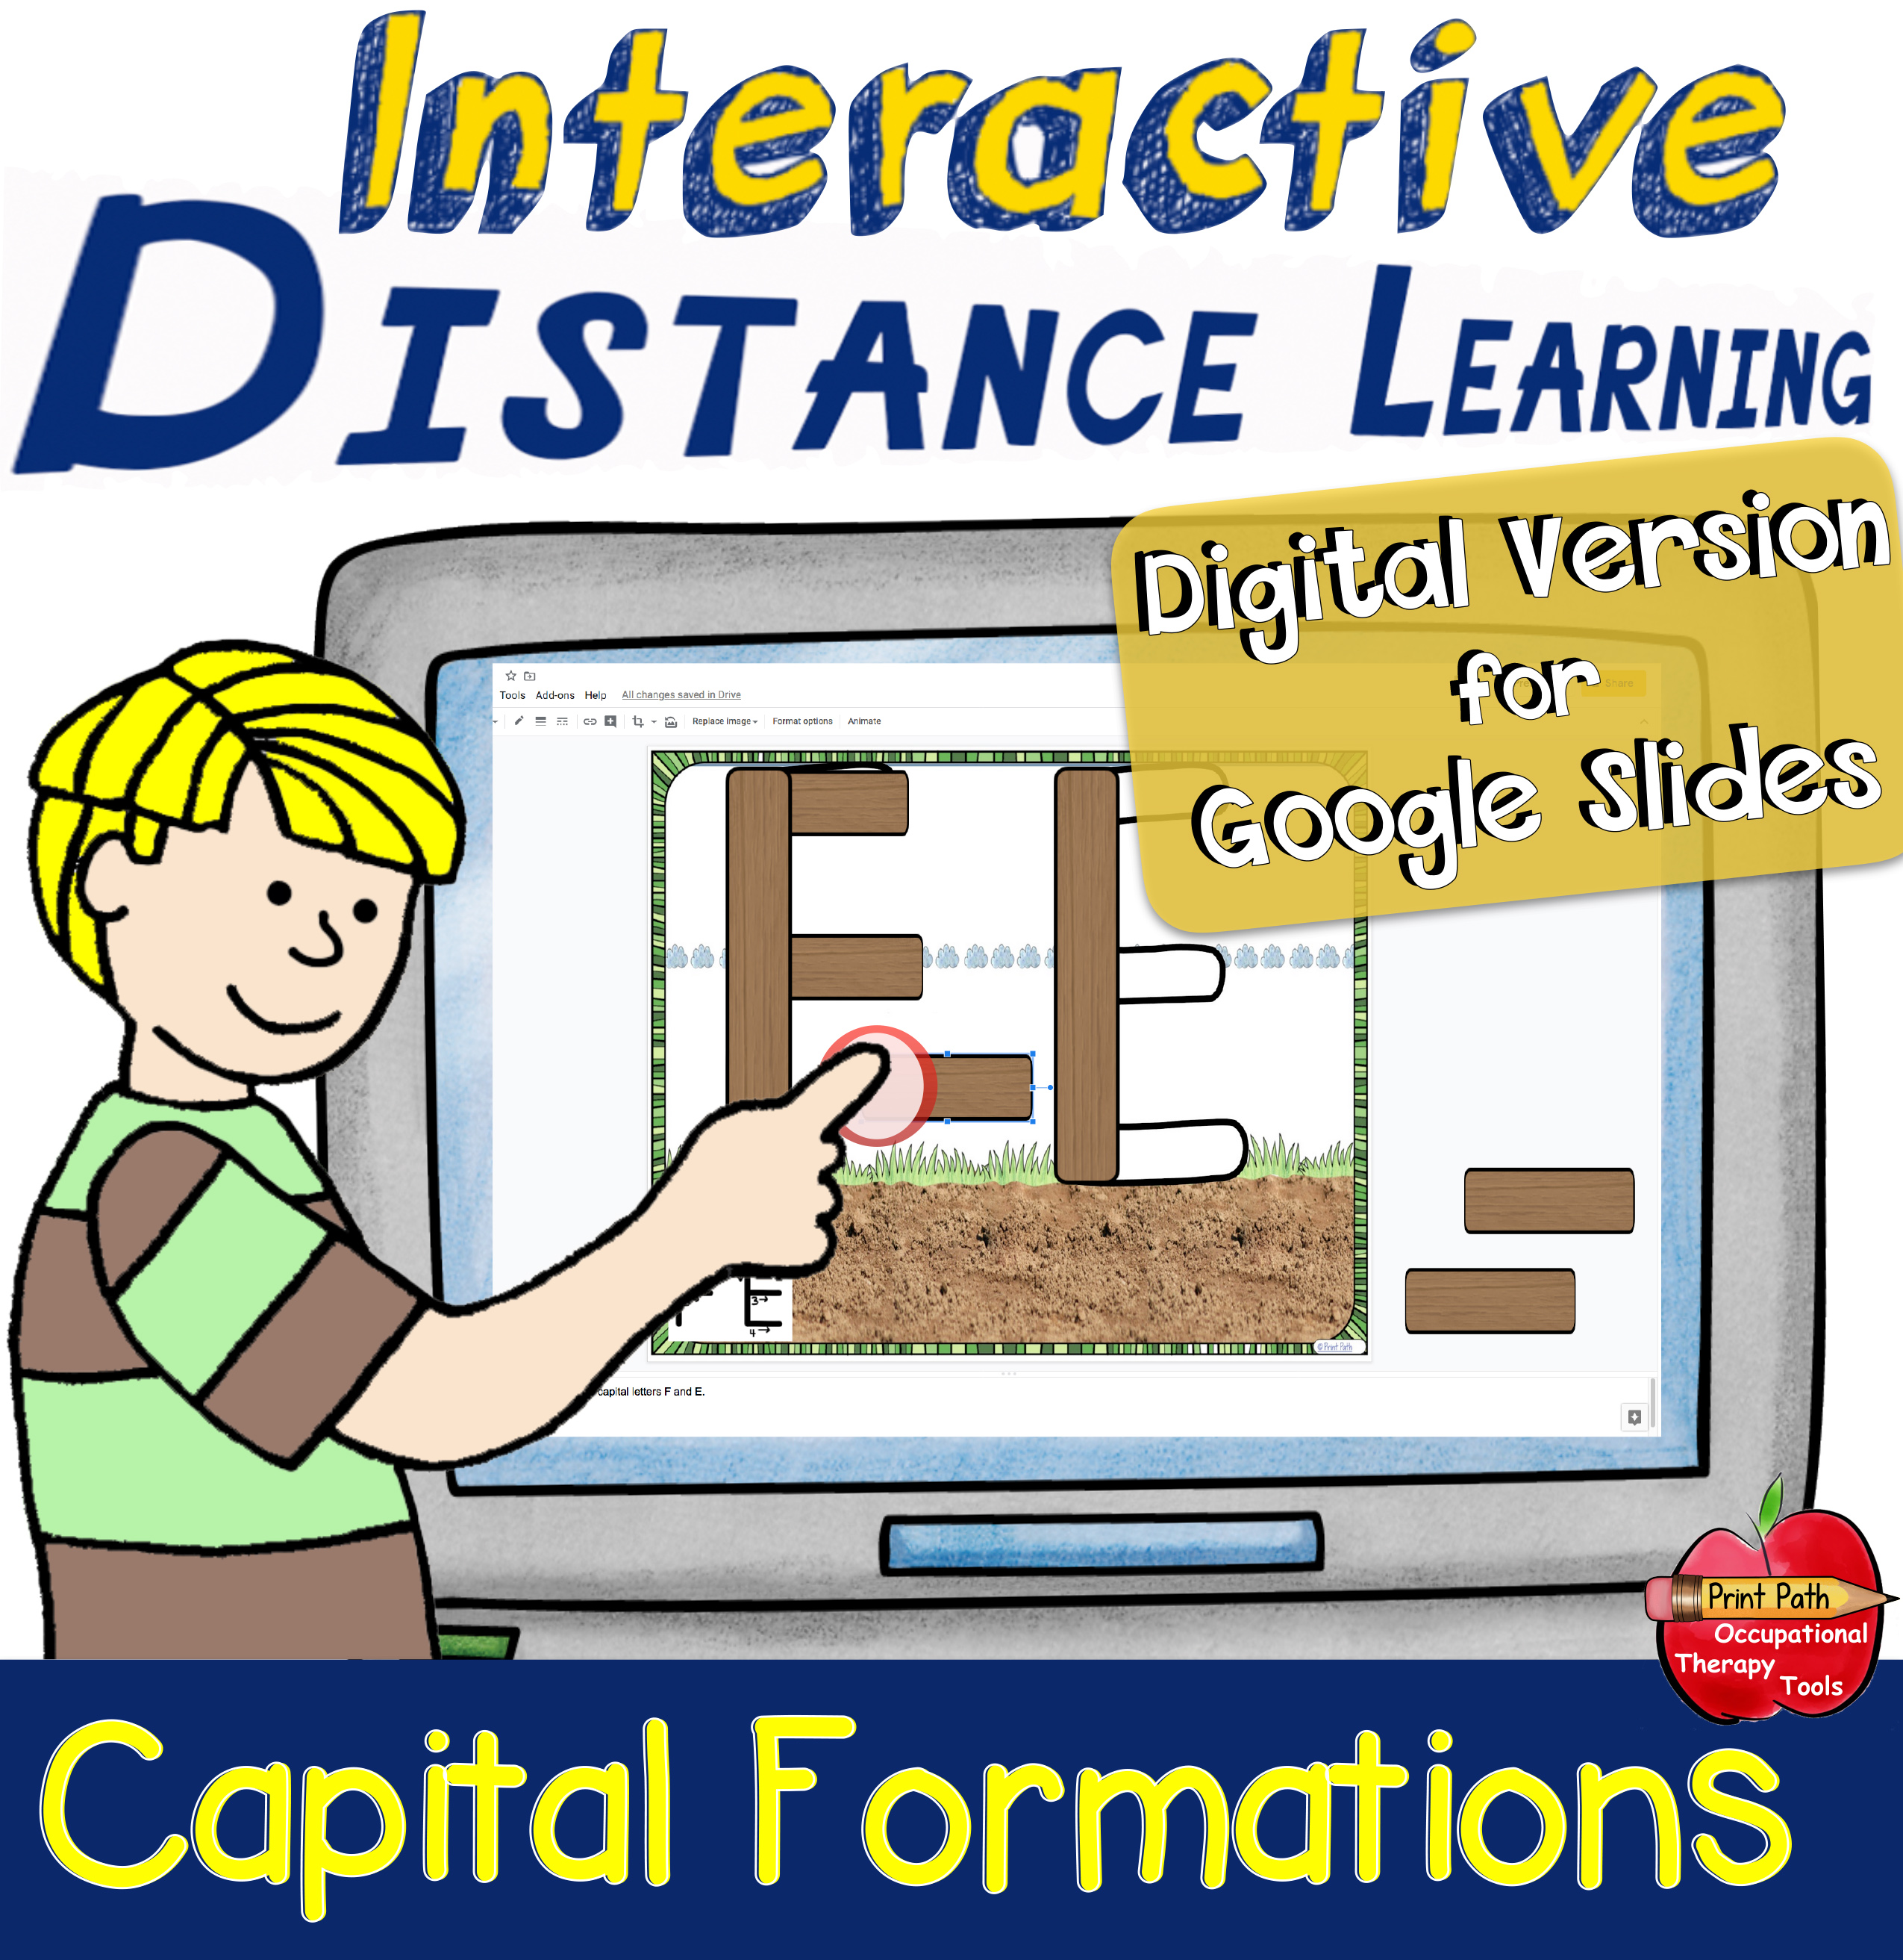
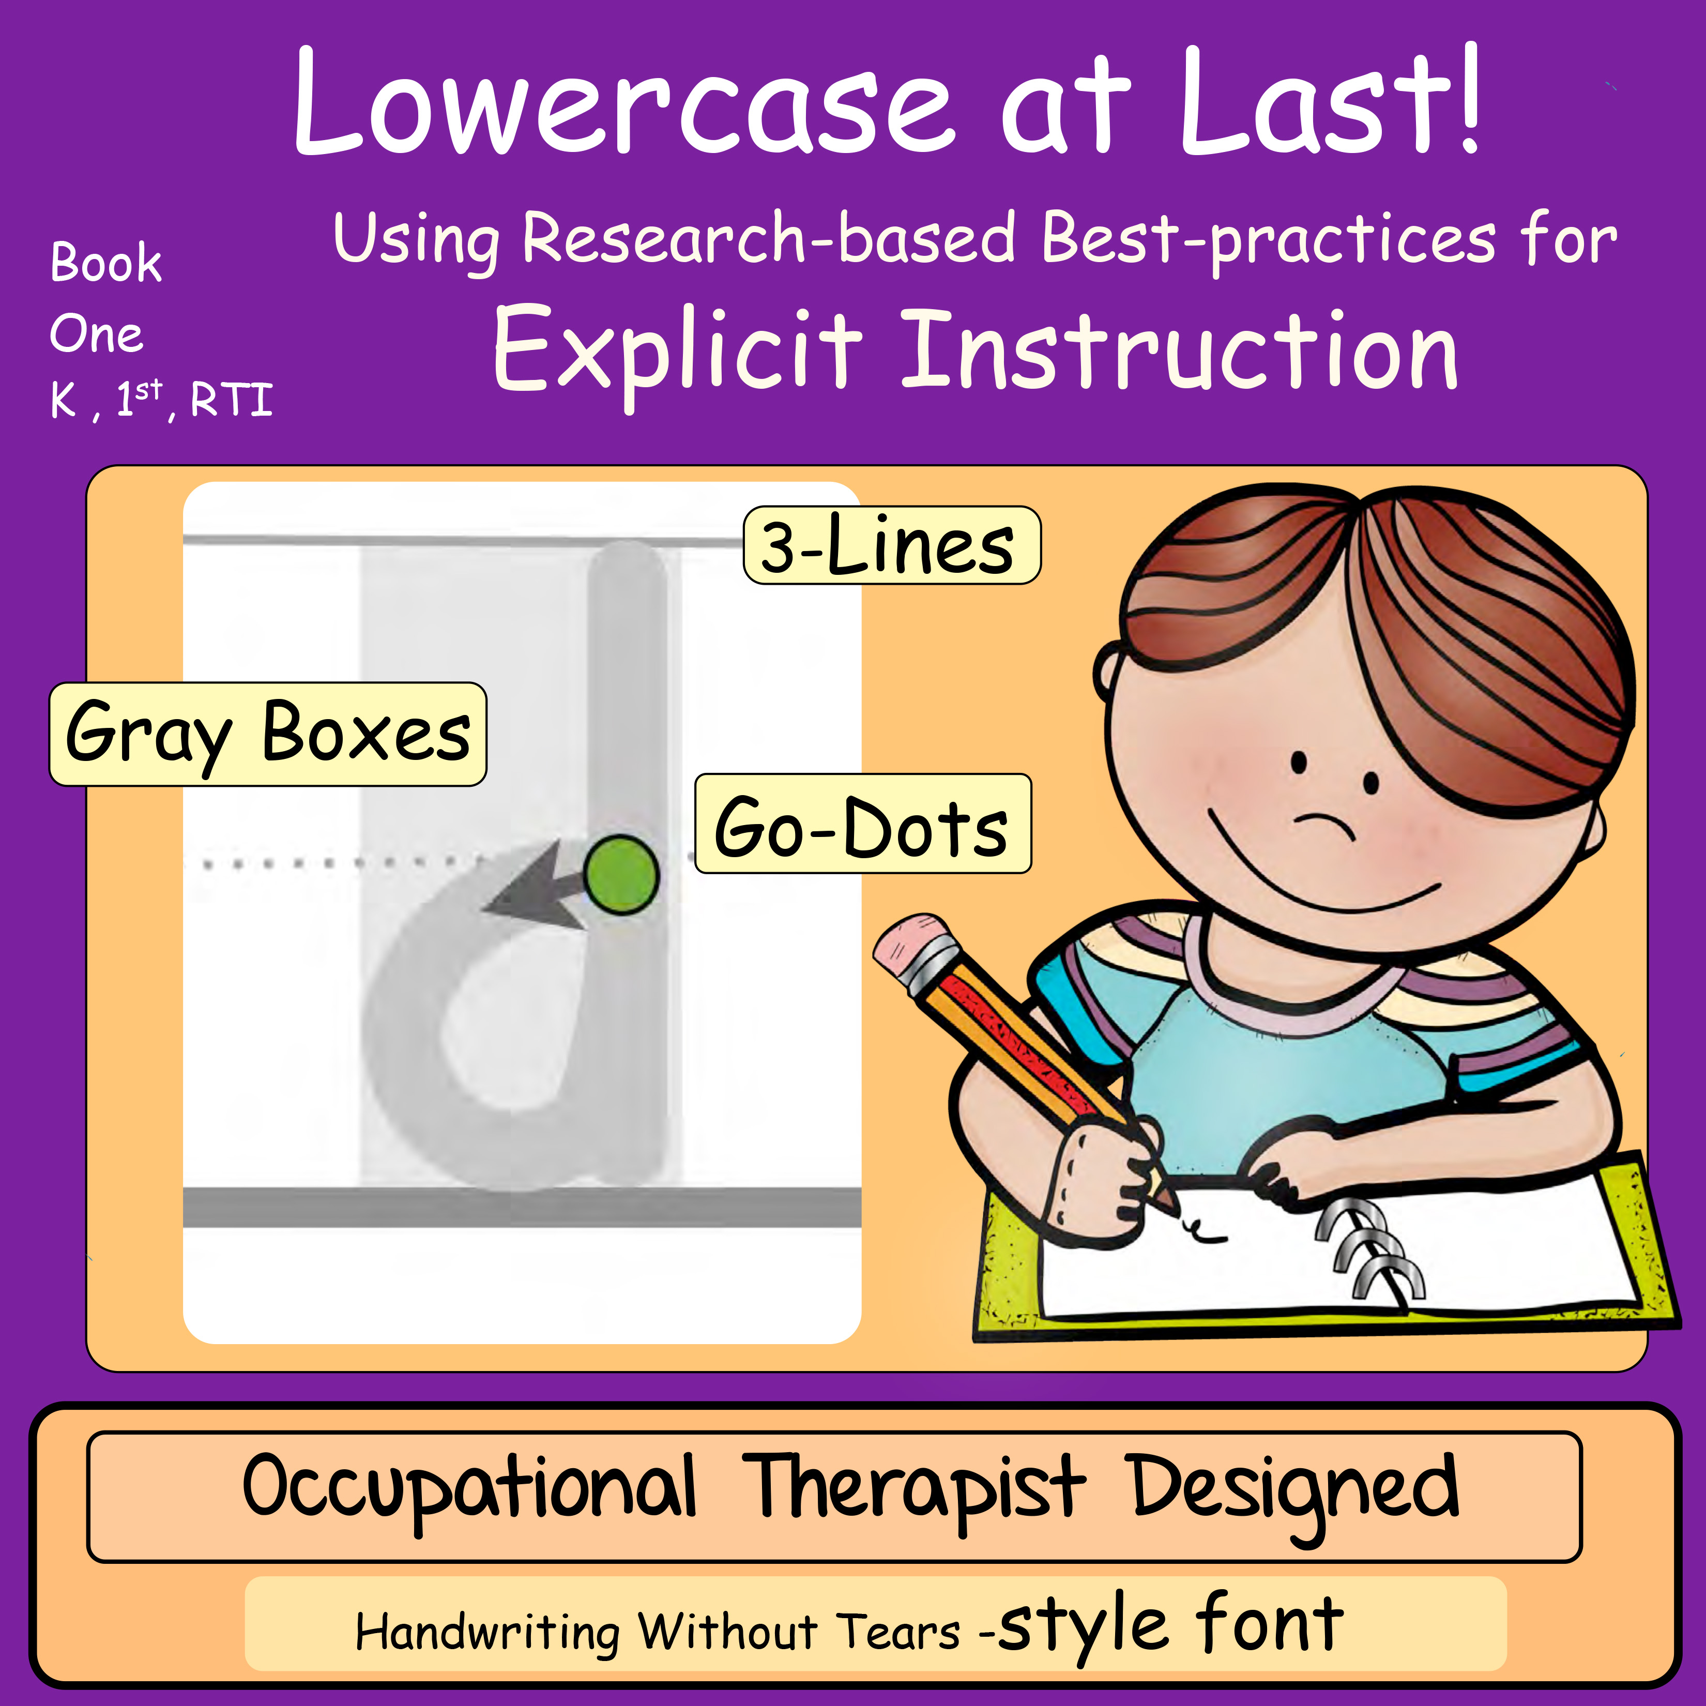
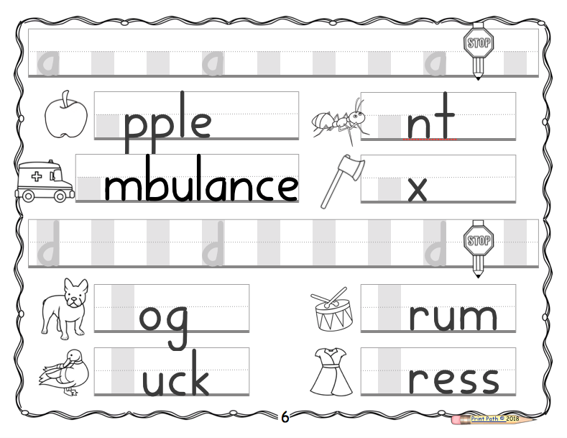
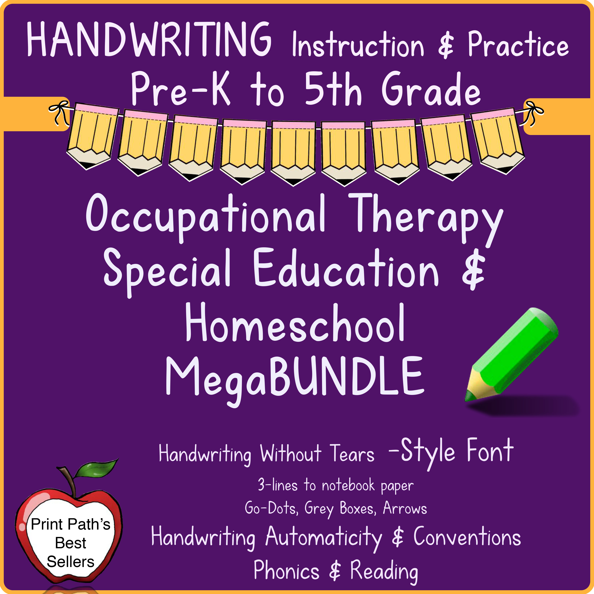
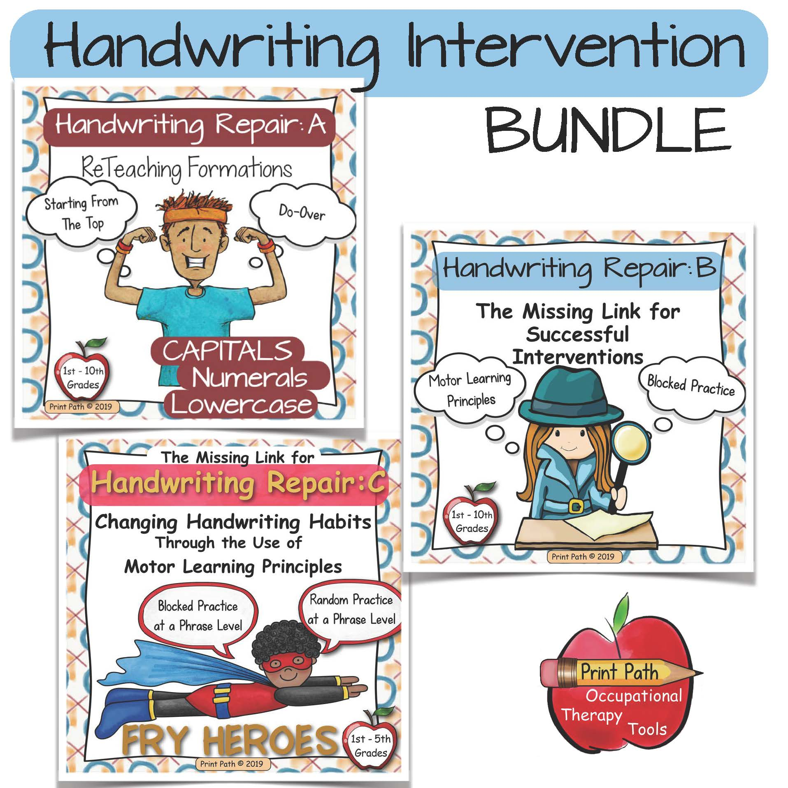
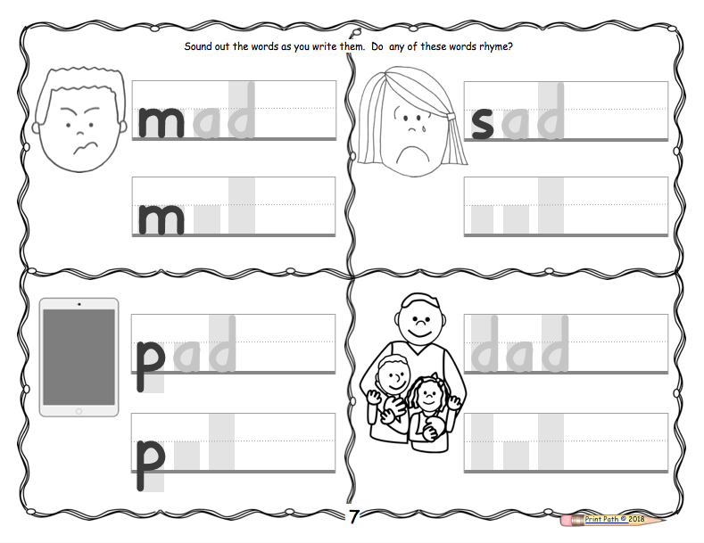
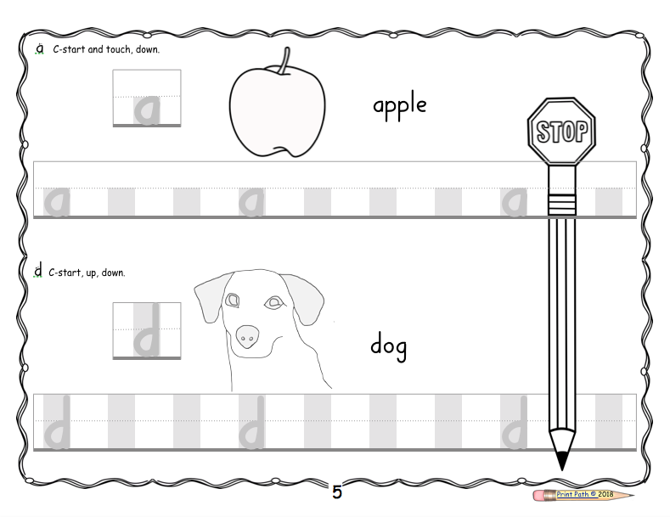
Related Products
Print Path OT
Print Path © 2020
INTERACTIVE for PowerPoint
INTERACTIVE for Google Slides
Handwriting Tools:
Sequence of handwriting instruction:
Capitals First!: Book One [PreSchool / Kindergarten]
Capitals First!: Book Two [PreSchool / Kindergarten]
Numbers Next Bundle [PreSchool]
Numbers Next Practice Book [Kindergarten]
Lowercase at Last!: Book One [Kindergarten/ 1st Grade]
Lowercase at Last!: Book Two [Kindergarten/ 1st Grade]
Winged Writers [First Grade]
Handwriting Superstars [Second Grade]
Raise the Roof [Third– Fifth Grade]

Slide 15
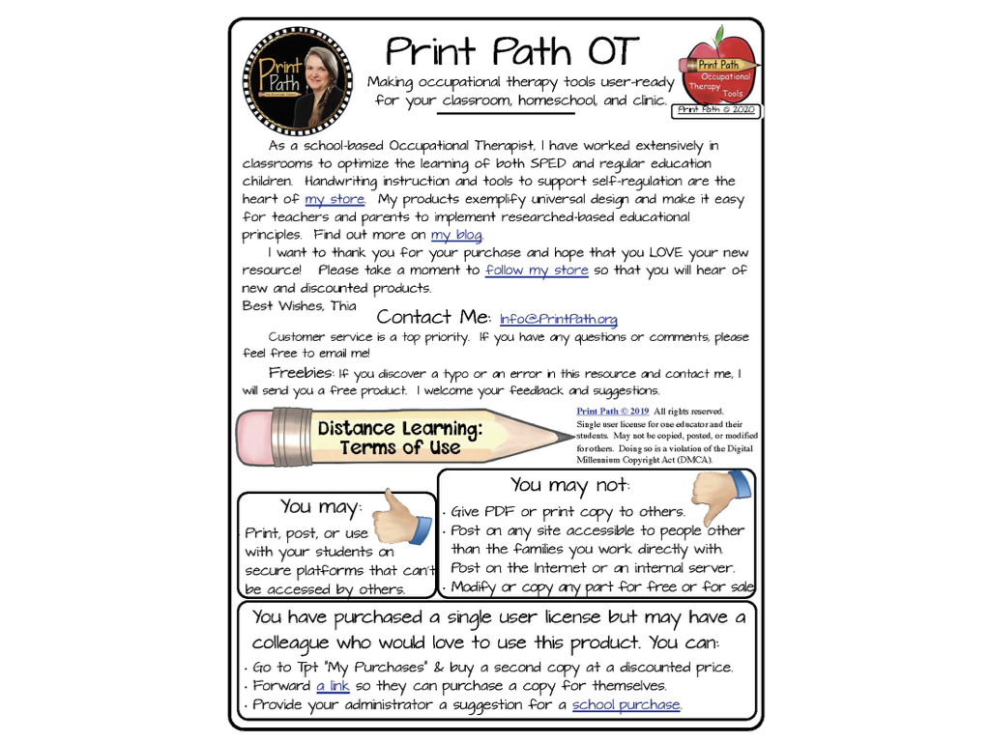

Slide 16
