Slide 1


Slide 2
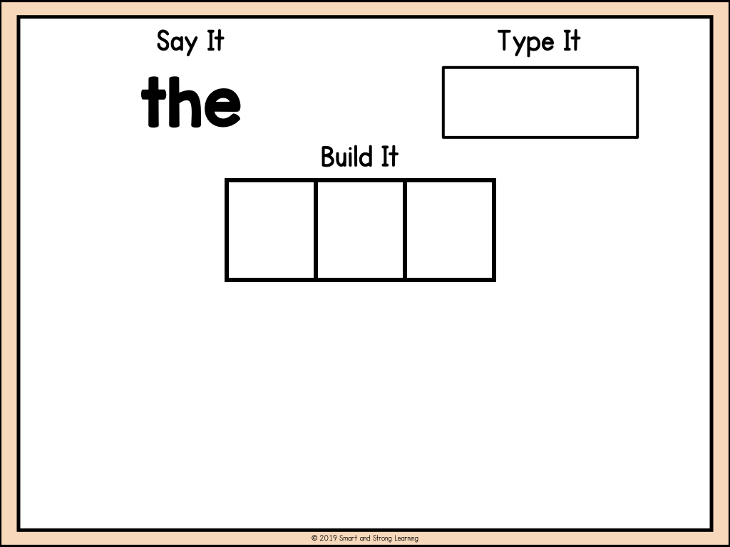



























Slide 3


Slide 4


Slide 5
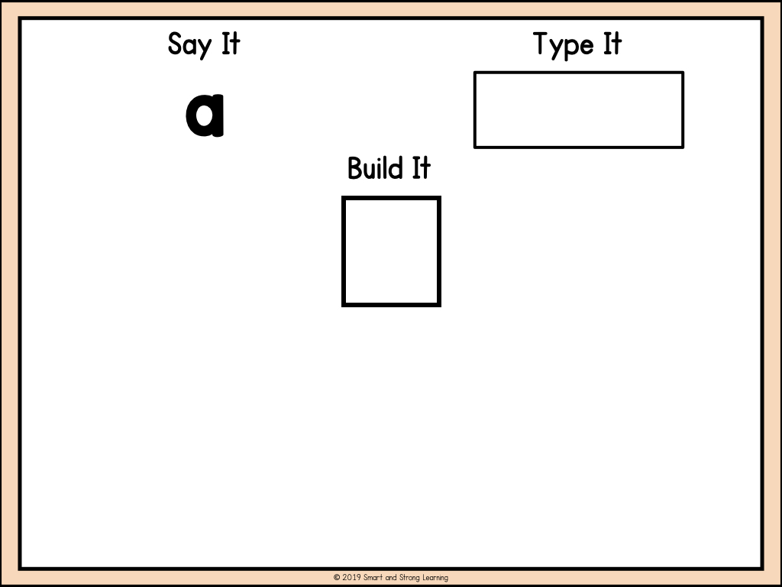

Slide 6
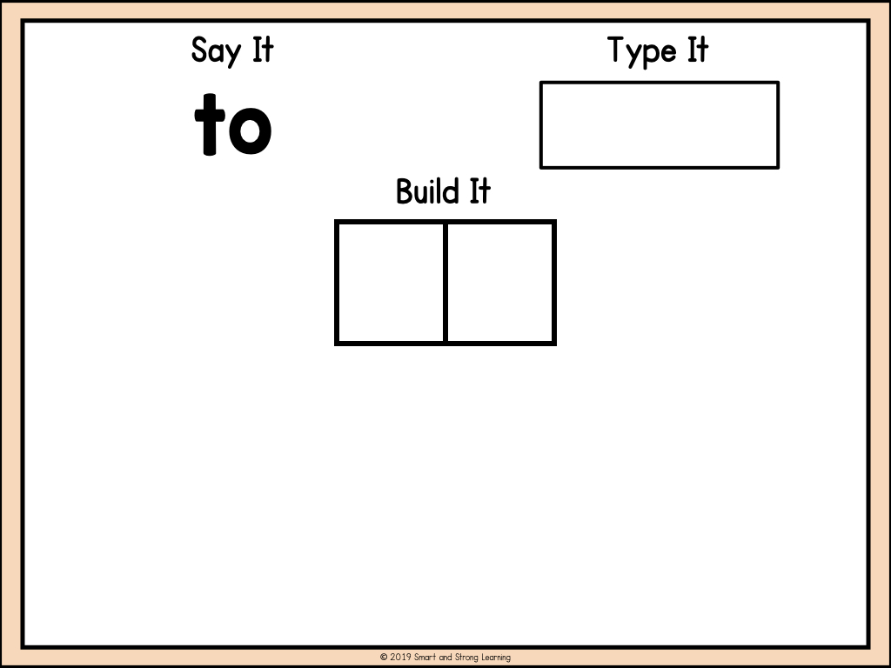

Slide 7











ßßß
Thank You!
Thank you so much for choosing this product! I’ve worked really hard on the details of every product. If you have any questions please email me smartandstronglearning@gmail.com.
Follow my store for future products, sales, and freebies!
Earn free TPT credits you can use toward products anywhere on the TPT website by leaving feedback on paid products. Positive feedback means so much and I love hearing how my products are being used.
smart-and-strong-learning
@smartandstronglearning
smartandstronglearning
smartandstronglearning
@gmail.com
ç√
Terms of Use
Purchasing this product gives the right for one person to use this product in the home, classroom or therapy. Sharing copies of this resource with colleagues it is fine if you purchase an additional license. For more info, TPT Copyright & Trademark Policy.
ç√
Clip Art & Font Credits
www.smartandstronglearning.com

